Slide 1

Shiny
Web development through R

Slide 2
Outline
Workshop sessions
Introduction, Structure & Basics - 10th Jan
More advanced elements – 17th Jan
Interactivity and renderUI – 24th Jan
Troubleshooting & “BYO-App” session Fisheries Informatics project – 31st Jan
– Optional hands on session
Github session

Slide 3
Session 1
Outline
Introduction to shiny
Structure & Basic code template
6 basic examples
Fisheries Informatics apps
- Functionalities

Slide 4

Shiny!

Slide 5
Shiny
What is it?
An R package that makes it easy to build interactive web applications (apps) straight from R.
Structure
ui
What it looks like
app.R
(R script)
What it does
server
Makes it work
shinyApp(ui,server)

Slide 6
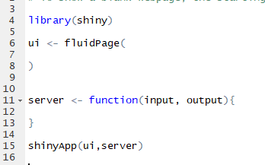
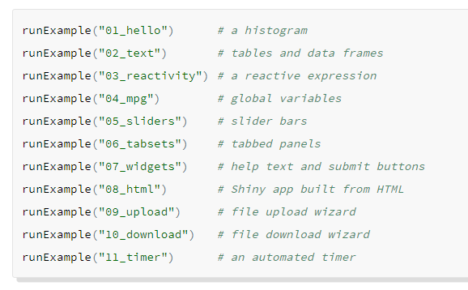
R code
Template – Example 1-0
Examples – Built in

Slide 7
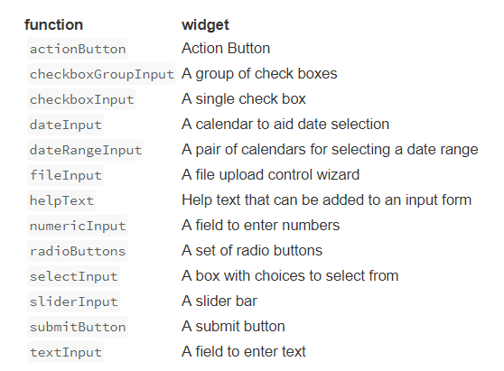
Widgets
To add a widget, place a widget function in your ui object with;
A name for the widget. The user will not see this name but you can use it to access the widgets value and create reactive elements based on it.
A label. This should be a character string and will appear with the widget in your app. it can be an empty string “”.
In this example the name is “action” and the label is “Action”

Slide 8
Now you…
Examples 1-6

Slide 9
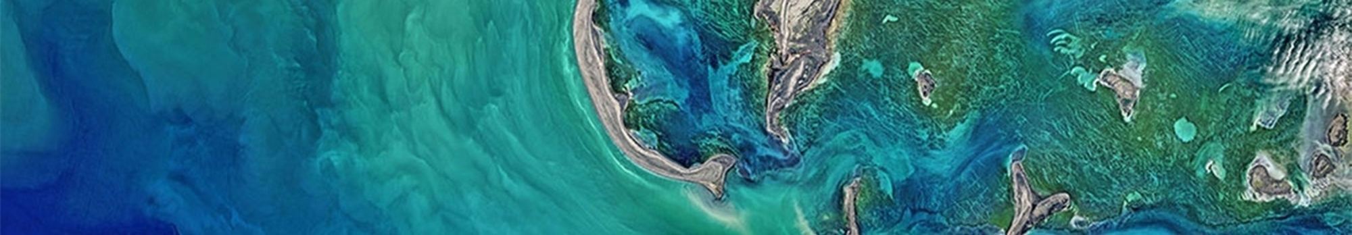
Fisheries Informatics Project
MI based project aiming to visualize existing data, increase its usage/utility and make it more easily accessible.
Outputs;
Species Dashboard
Digital Stockbook
IGFS data explorer
Cod tagging data portal

Slide 10
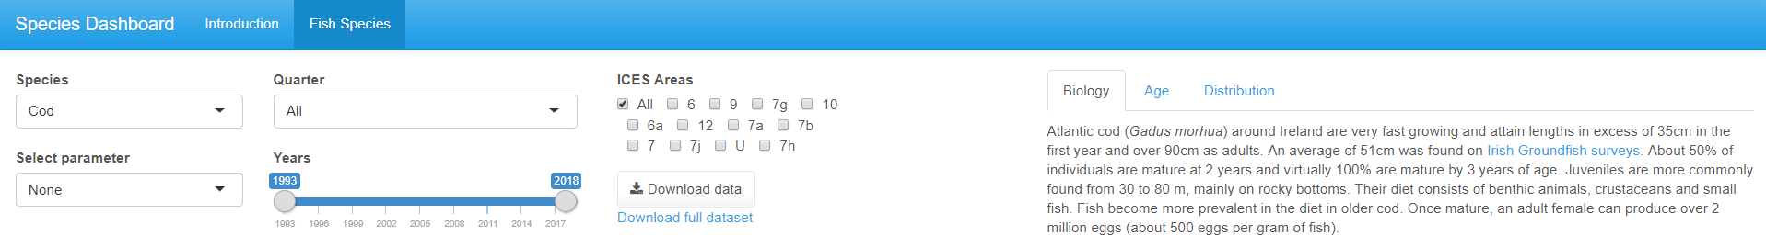
Species Dashboard
Multiple tabs
Interactive plots
images
tabPage
plotly
www folder and renderImage
Action buttons
tabPage

Slide 11
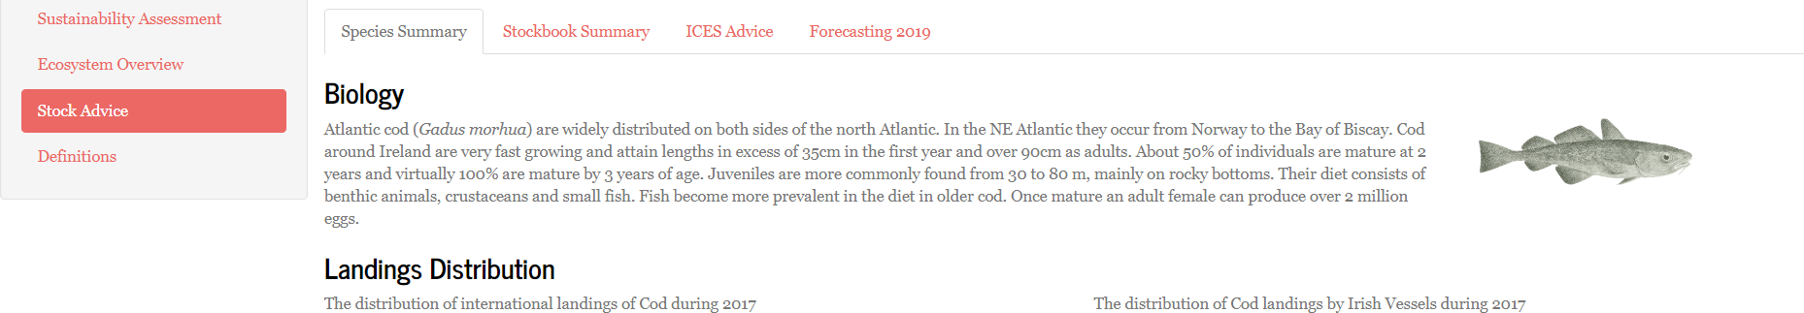
Digital Stockbook
renderUI

Slide 12
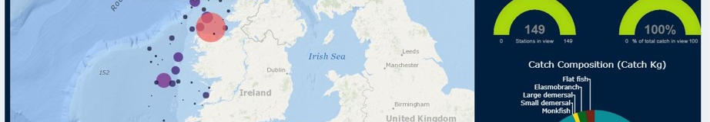
IGFS Data Explorer
Leaflet pop-ups
View & download PDF
Reactive charts and infoboxes

Slide 13
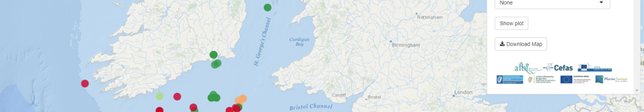
Cod tagging
Leaflet + adaptive page
Download map

Slide 14

Session 2
Outline
Layout options
HTML and formatting
Plotly
Leaflet
Fisheries Informatics apps
- the code that built them

Slide 15
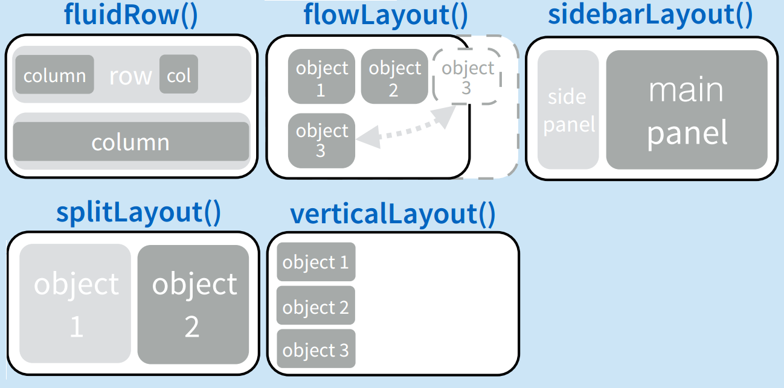
Layout
fluidPage
Most used and very flexible
titlePanel and sidebarLayout are most commonly used elements to add.
Combine multiple elements using different panel functions.
Organise panels and elements into a layout using a layout function with elements as arguments.

Slide 16
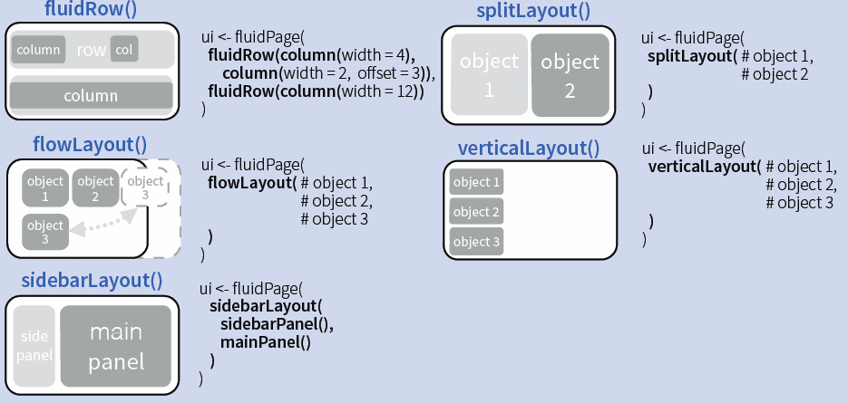
Layout code examples

Slide 17
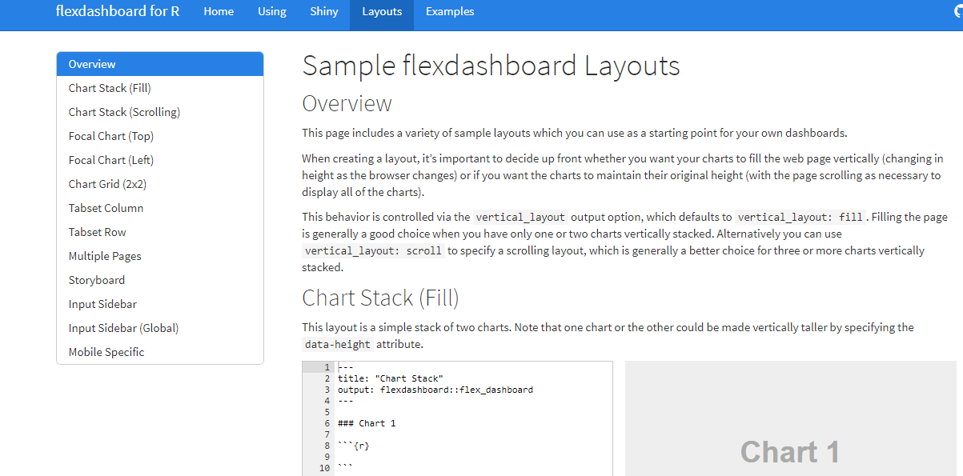
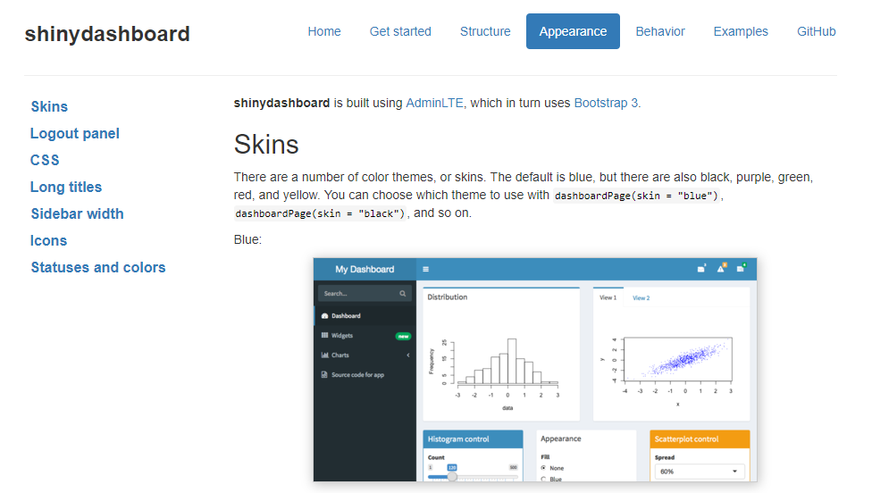
Layout
flexdashboard
shinydashboard
R Markdown
Super easy
Static or Dynamic
CSS flexbox layout
link
Shiny UI code, built using AdminLTE
Not quite as easy
Dynamic
Bookstrap grid layout
link
For more - layout-guide

Slide 18
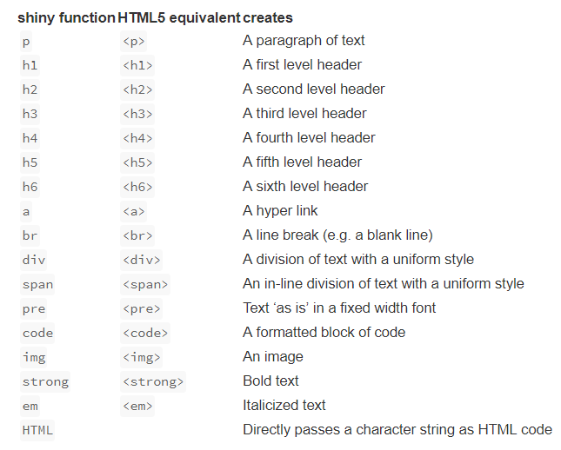
Adding content & Formatting
You can add content to your Shiny app by placing it inside a *Panel function e.g. sidebarPanel("sidebar panel")
Format text using inbuilt tags to create Headers, alter alignment, bole/italicize, change colour etc.
You can also customize your UI with HTML
Shiny HTML tags glossary
Notes:
You can add content to your Shiny app by placing it inside a *Panel function
Adding characters; html site hyperlink so you can look up the appropriate wrapper tag to allow you to include unusual characters (e.g. less than or equals to sign, subscript etc)

Slide 19
Adding links

Slide 20
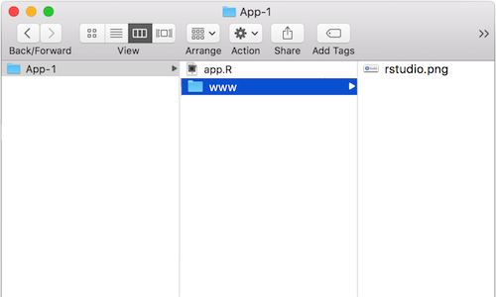
Images
‘img’ function with name of your image file as src argument
Can also include HTML friendly parameters like heights and width (numbers refer to pixels)
Img fuction looks for your image in a specific place; so your file must be in a folder named ‘www’ in the same directory as your app.r script.
So if you wanted to use an image called rstudio.png, your App-1 directory should look like this;

Slide 21
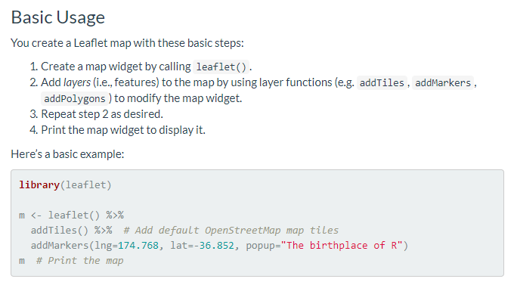
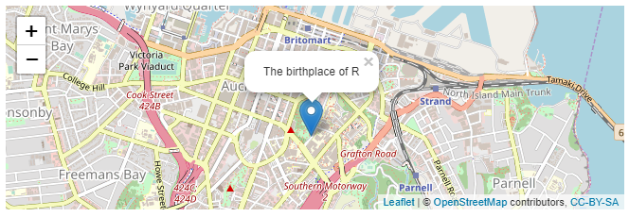
Mapping - leaflet
ui <- renderLeaflet(m)
More info: https://rstudio.github.io/leaflet/

Slide 22
Incorporating plots/graphs
Plot fuction
Normal R plotting code inside renderPlot()
ggplot
Notes:
Tidyverse integration,

Slide 23
Interactive plots - Plotly
https://plot.ly/r/
Can also wrap ggplot inside renderPlotly(); will make your plot interactive

Slide 24
ggplot example
Normal gg plot code – output as is
Wrap within plotly and demo interactivity

Slide 25
Tables - Datatable

Slide 26
Session 3
Outline
Interactivity
renderUI function
Troubleshooting
Reactive plotting – tagging app, code to allow you to chose your plot parameters
Tips and tricks
- Additional resources

Slide 27
Google analytics

Slide 28
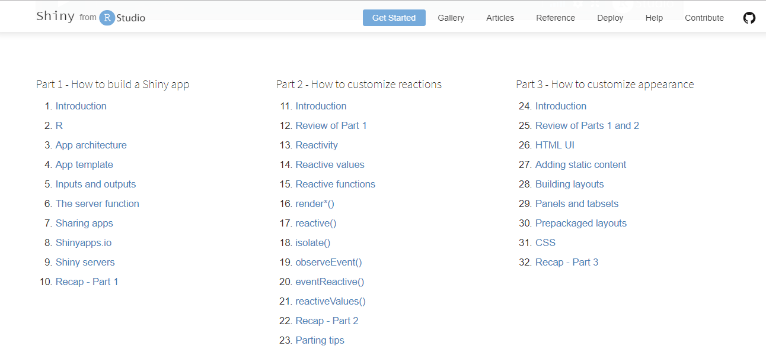
Shiny – Online tutorials
https://shiny.rstudio.com/tutorial/

Slide 29
Other Resources
https://www.rstudio.com/products/shiny/shiny-user-showcase/
https://shiny.rstudio.com/gallery/
http://gallery.htmlwidgets.org/
https://www.r-graph-gallery.com/
https://rmarkdown.rstudio.com/flexdashboard/
https://github.com/d3/d3/wiki/Gallery
http://myinspirationinformation.com/visualisation/d3-js/integrating-d3-js-into-r-shiny/
https://rstudio.github.io/promises/articles/shiny.html
http://spatial.ly/
https://flowingdata.com/category/tutorials/

Slide 30

Questions?

